Slide 1
Interdisciplinary School-Based Nurse Managed Primary Health Center: Health Literacy Challenges and Successes
Dr. C. Victoria Framil, DNP, ARNP, ANP-BC
John H. Peavy Clinic Manager
FIU: Nicole Wertheim College of Nursing and Health Sciences Graduate Assistant Professor
Florida Nurses Association Health Policy Special Interest Group Chair

Slide 2
Objectives
Participants will hear about strategies to address the challenges with educating families about
Accessing preventative and primary care resources
Navigating the health care system
Advocating for a healthier community

Slide 3
Notes:
The purpose of the project is to develop an inter-professional school-based family-centered nurse-managed clinic at Miami Northwestern Senior High School, which supports the development of a collaborative practice environment that will increase access to high quality primary care, and enhance health outcomes for students and families in the underserved area.

Slide 6
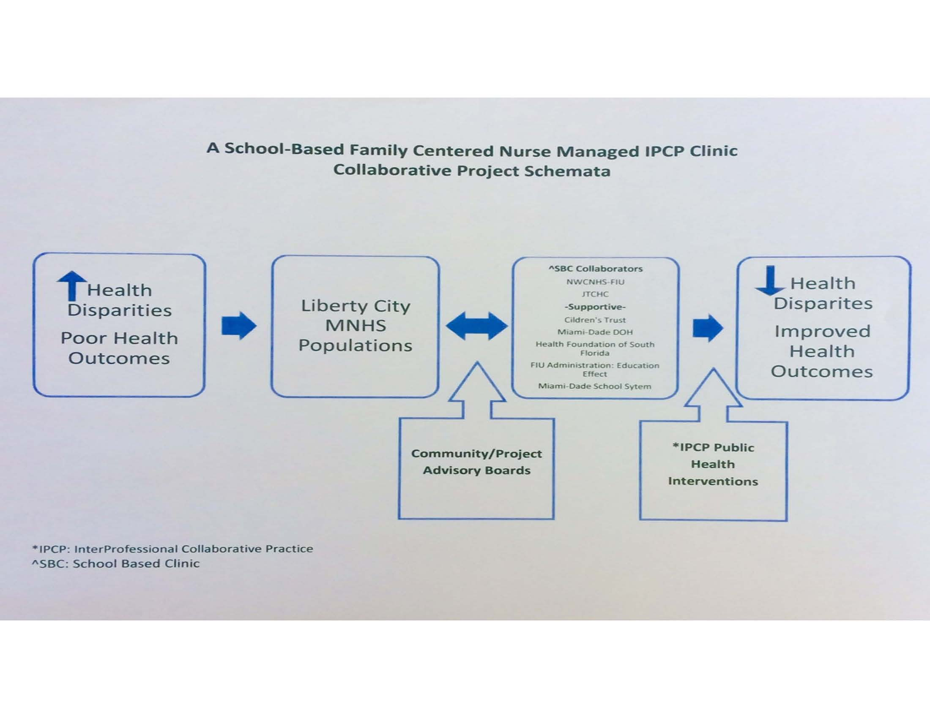

Slide 7
GOALS
Establish an inter-professional nurse-managed primary care clinic
Team based collaborative practice that provides training opportunities for students in the health professions and cultivates emergent nurse leaders to demonstrate leadership in inter-professional team building , problem solving and collaborative care.
Increase access to culturally competent public health care
Develop a process and outcomes focused quality evaluation plan.
Notes:
We will focus the most on the aspects related to navigating and accessing healthcare for the underserved.

Slide 9
Notes:
Additionally hours of operations that allow for the non school community to use the clinic were extended from 3:30pm to 6:30pm M-F and on Saturdays from 9am to 1pm. One of our challenges has been that historically, this clinic was available only to the students at the school. The community member then think that it is still only for the students.

Slide 11
Cultural Competence Definition
The increasing diversity of the nation brings opportunities and challenges for health care providers, health care systems, and policy makers to create and deliver culturally competent services. Cultural competence is defined as the ability of providers and organizations to effectively deliver health care services that meet the social, cultural, and linguistic needs of patients.¹
A culturally competent health care system can help improve health outcomes and quality of care, and can contribute to the elimination of racial and ethnic health disparities.
Notes:
Culturally competent care is linked to and especially important in the context of health literacy issues. It is important to determine what/how the population you serve prefers to receive care and health education. This particular neighborhood has many different new immigrants that are arriving daily. From central and south American and from Caribbean countries such as Haiti. The PR and Marketing plan has also needed to be adjusted to determine how to reach the community we are trying to serve. We’ve implemented culturally competentency training for the faculty, staff and students of both the federally qualified health center we are partnering with and the FIU team. Staff available that speak Spanish, English and creole.

Slide 13
Notes:
Our outreach arm for the clinic is called COREACH

Slide 15
Notes:
The purpose of this project is to identify healthcare problems and needs in citizens within the Liberty City community and link individuals with health needs and concerns to healthcare providers in order to bridge healthcare gaps and improve health outcomes. The target population is considered “partners in health”. The IPCP in NWCNHS and the CO-REACH team was tasked with creating and participating in outreach events at the school and in the community. CO-REACH is intended to enhance and improve health outcomes of the community though identification, engagement and participation of hundreds of residents who have limited of no access to primary care by utilizing healthcare and peer navigators

Slide 16
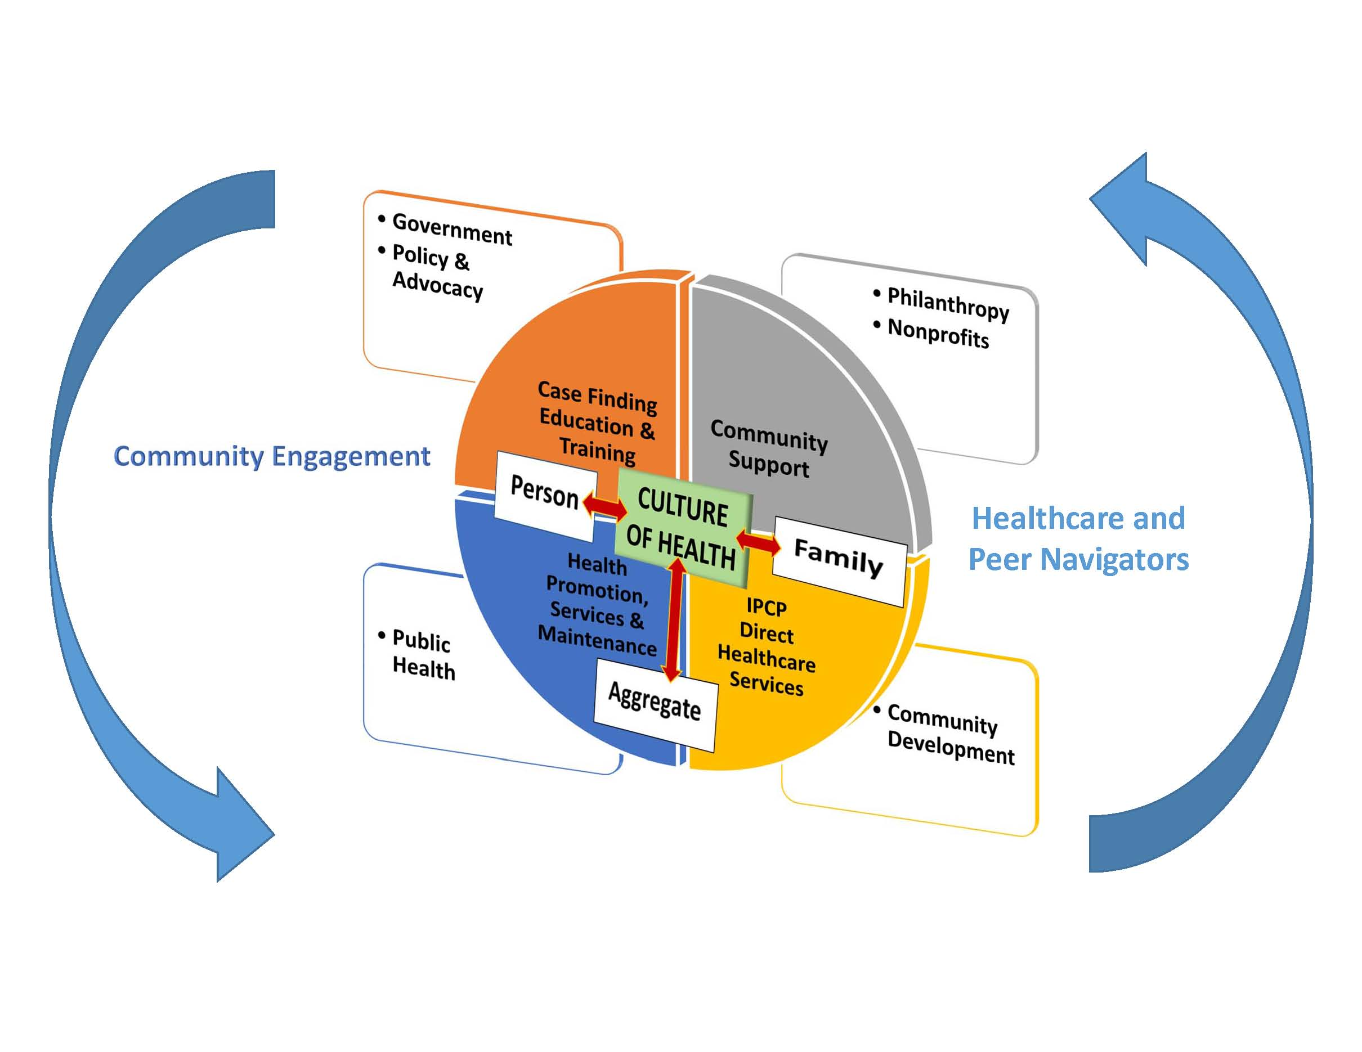
CO-REACH: The Matrix to Health

Slide 17
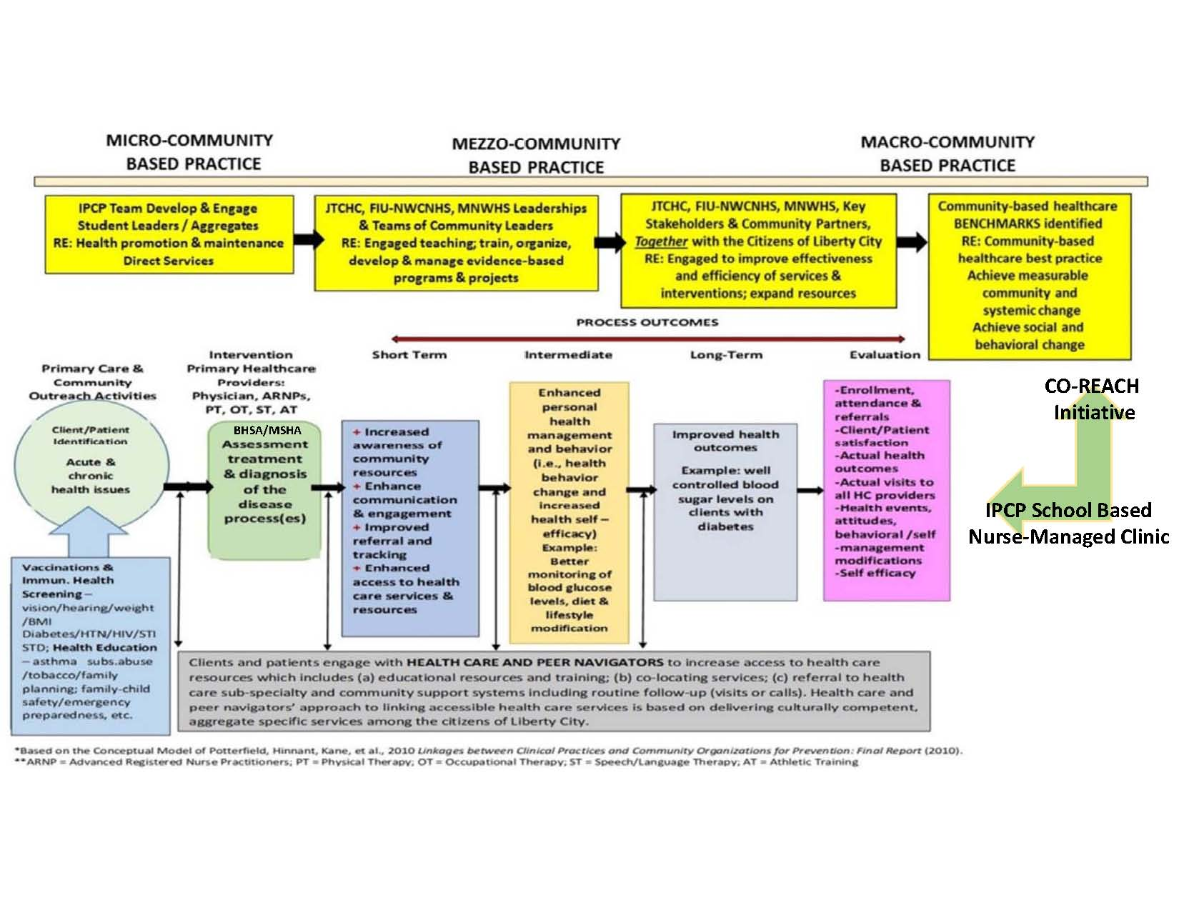

Slide 20
Navigators
Health Care Navigators
Licensed healthcare practitioners with knowledge in care and management of disease process who seek to enhance positive health outcomes through the provision of specific navigation tools and support to clients and patients
Peer Navigators
Defined as community role models that are trained staff members (not volunteers) who share understanding, experiences and cultural ethnic identity with the concerned client
Seeking and addressing client’s individual barrier(s) to healthcare, assist in gaining healthcare access and community support services and community outreach.
(Ali-Faisal, Colella, Medina-Jaudes, & Scott, 2016)
(Tho & Ang, 2016)
Notes:
Studies support the effectiveness of peer and health navigators to improve patient satisfaction, increased likelihood of patients access health screenings and attending recommended care events. We have additionally found this to be true. When we hired our Peer Navigator and markedly increased our community outreach efforts we have seen an increase in patients coming to the clinic and accessing the services.

Slide 21
Outreach/Meeting Outcomes
Event Name | Organization Name | Date | Contact Person | Number of People Attended | How many Promotional Materials Distributed | Notes/Comments
Senior Parent Night | Miami Northwestern High School | 4/20/2016 |  | 150-200 parents | Introduced students to programs/careers | Dr. Framil and Dr. Vera with select Jessie Trice and Education effect team members
Career Fair | Miami Northwestern High School | 4/22/2016 |  | 200 | Radio Play | Dr. Framil and Ms. Joanne Pierre
Career Technical Educational Education Explosion | Miami Northwestern High School | 4/30/2016 |  | 8th graders and parents - attendance numbers are unfortunately not available - Numbers were low | Lunch | Dr. Framil
Miami Northwestern High School Alumni Meeting | Miami Northwestern High School | 5/14/2016 |  | Parents and alumni glad to support | "What can we do for MNWHS" | Dr. Vera and Dr. Framil
Catalyst Miami event | Liberty Square | 5/14/2016 |  | attendance numbers are unfortunately not available - Numbers were low
Community Showcase and Health Fair | African Heritage Cultural Arts Center | 5/14/2016
City Year |  | 5/20/2016 |  |  |  | Ms. Pierre
Amerigroup Healthfair | John H. Peavy | 5/21/2016: 9am-1pm |  | expected attendance 200 | Signed up students for physicals | Dr. Vera and Ms. Pierre
Communities Talk: Town Hall Meeting, Youth Facilitated Discussion on Prevention of Underage Drinking and Substance Abuse. | Gang Alternative, Inc. & Urban Partnership Drug Free Community Coalition & SAMHSA | 6/16/2016 | Vivilora Perkins Smith / Vperskinssmith@myga.org | 60 Children / 30 Adults | 70 Palm Cards / 5 Personal Contact Cards | Met Michele Wyatt-Sweeting, Program Director - New Horizons Community Mental Health Center Inc. Msweeting@nhcmhc.org
Honey Shine Summer 2016 School Physicals | Carrolton School of the Sacred Heart | 6/21/2016 | Brittney Gonzalez / Bgonzalez@honeyshine.org | 15 children | Physical assessments provided | In coordination with PT, hearing and vision screenings

Slide 22
Honey Shine Summer 2016 School Physicals | Carrolton School of the Sacred Heart | 6/21/2016 | Brittney Gonzalez / Bgonzalez@honeyshine.org | 15 children | Physical assessments provided | In coordination with PT, hearing and vision screenings
A Build Health Challenge Meeting | Liberty City Community Collaborative for Change | 6/23/2016 | Deltavier Frye, Project Coordinator / Deltavier.Frye@Flhealth.gov | 25 Adults | 20 Palm Cards / 5 Personal Contact Cards | Community Organization Representatives and residents sharing strategies, discussions and planning
Community Outreach | Local Busineses | 7/5/2016 | Targetted Outreach | 52 Adults | 52 Pamphlets / 10 personal Contact Cards | Direct contact with community members and business owners
Honey Shine Summer 2016 School Physicals Day 2 | Carrolton School of the Sacred Heart | 7/12/2016 | Brittney Gonzalez / Bgonzalez@honeyshine.org | 5 Children | Physical assessments provided | Identified 3 students with deafness and 1 with scoliosis. Referred.
Catalyst Open House | Catalyst Miami | 7/14/2016 | Adele Coble / adelec@catalystmiami.org | 15 adults | 5 Pamphlets | Met Public allies director, and Santra Denis / SantraD@catalystmiami.org
Community Outreach | Local Busineses | 7/19/2016 | Targetted Outreach | 45 Adults | 45 Pamphlets / 5 personal Contact Cards | Direct contact with community members and business owners
Zika Awareness event Sponsored by United Health Care | United Health Care & JTCHC | 7/23/2016 | Toni Thompson, JTCHC / TMThompson@jtchc.org | 60 Adults | 60 Pamphlets / 10 Personal Contact Cards | Met Lekeshia Bush, PharmD, AAHIVP, Walgreens / Lekeshia.Bush@walgreens.com
Liberty City Promise Grant meeting | Miami Children's Initiative | 8/4/2016 | Cecilia Gutierrez / cgabety@miamichildrensinitiative.org | 30 members of various community organizations | Discussion to put forth a strong grant proposal | Dr. Framil and Avi Sukhram
Health Connect: Children's Trust Professional development | Rockway Middle School | 8/9/2016 | juliette@thechildrenstrust.org | 200 individuals educated | presentation on medical errors and sexually transmitted infections | Met Dr. Paulo Graziano, Ph.D. FIU Director, S.E.L.F.-Regulation Lab / Pgrazian@fiu.edu
Presentation on Diabetes Mellitus by Dr. Framil | Miami Northwestern High School | 8/11/2016 |  |  | Presentation on the review of Diabetes Mellitus, diagnosis and management | Presentation to Jessie Trice school nursing faculty
Commissioner Edmondson's Back to School Event | Olinda Park | 8/13/2016 | Toni Thompson, JTCHC / TMThompson@jtchc.org | 30 adults | blood pressure screenings | Met Ms. Linda Lott, Outreach coordinator for JTCHC
Back to School Bash Day 1 | John H. Peavy | 8/15/2016 | NA | 10 adults | blood pressure screenings and glucose sticks
Back to School Bash Day 2 | John H. Peavy | 8/16/2016 | NA | 2 sign in sheets/ 30 patients w/contact info | Clinic information provided

Slide 23
Back to School Bash Day 2 | John H. Peavy | 8/16/2016 | NA | 2 sign in sheets/ 30 patients w/contact info | Clinic information provided
Opening Day Event On FIU Campus | FIU | 8/18/2016 | Event hosted by Education Effect |  | Clinic information provided | Presentation about JHP to faculty of Lillie C. Evans, Dr. Framil and Joanne Pierre
Health Resource Fair via Education effect | Jessie J McCrary Elementary School | 8/19/2016 | Donnie Hale/dhalejr@fiu.edu | 15 adults screened / 1 Asthma educated | blood pressure screenings / glucose sticks / Asthma education
Health Fair | Jessie Trice Main Health Center | 8/20/2016 | Toni Thompson, JTCHC / TMThompson@jtchc.org | 5 adults screened/ 5 patients with Asthma educated | blood pressure screenings and Asthma education | Met Mr. Miguel Luna, United Health Care / miguel_i_luna@uhc.com
School Open House | Earlington Heights Elementary | 9/14/2016, 6-7:30pm |  |  |  | Adrian Astros
School Open House | Melrose Elementary | 9/14/2016, 5-7pm |  | 30 Pamphlets given out/ 5 patients with Asthma educated |  | Avi Sukhram
School Open House | Orchard Villa Elementary | 9/14/2016, 5-6pm |  | 100 parents |  | Dr. Framil attended
School health screenings | Georgia Jones-Ayers Middle school | 9/15/2016 | Magdalena Jean, Rn / Mjean@jtchc.org | Assisted with student health screenings |  | Tammy Ewing
School Open House | Henry Reeves | 9/15/2016, 6-8pm |  | attendance numbers are unfortunately not available - Numbers were low |  | Adrian Astros
Children's Trust, School Health Provider Meeting | Citrus health Network's Family Health Center | 9/16/2016: 10-11:30am | Cleo Chumiso / cleo.chumiso@thechildrenstrust.org |  |  | Dr. Framil attended
Educational Excellence School Advisory Committee Meeting (EESAC) | Liberty City Elementary School | 9/20/2016: 4:30-6pm | Dr. Campbell / School Principal | Committee meeting collaborating with students, parents and faculty | Established future collaboration with Liberty City Elementary to provide health education and possible screenings | Avi Sukhram, Eugenia Russell
US Department of Health and Human Services Office for Civil Rights and the JTCHC | Haitian Cultural Arts Center | 9/21/2016, 10-1pm |  | fellow peer navigators | Provide updates on sections of the Affordable Care Act | Sara Arias, Avi Sukhram
Open House | Brownsville Elementary | 9/21/2016 5-7pm |  |  | Provided info pamphlets about JHP to parents | Education effect attended and distributed flyers on our behalf

Slide 24
MNW Homecoming HS Football game | Traz Powell Stadium | 9/23/2016, 6-8pm |  | Approaching visitors at the game and informing about the JHP clinic (Engagement Limited, numbers low) | Informational pamphlets about the clinic given out | Dr. Framil, Toni Thompson, Adrian Astros, Avi Sukhram
School Open House | Henry Reeves | 9/27/2016, 5-8pm |  |  | Informational pamphlets about the clinic given out: Parent consent forms filled out | Joanne Pierre, Toni Thompson, Tammy Ewing, Adrian Astros, Naiviv Hernandez, Ingrid Leon, Avi Sukhram
Walk One Stop | Miami Dade Police Department, Northside District Station | 10/3/2016, 9:30-1pm | Wayne Rawlins / Wayne@waynerawlins.com | Door to Door outreach and offering various services, ie; social work, counseling, educational resources, career resources etc. | Informational pamphlets about the clinic given out (Lincoln Fields) | Naiviv Hernandez, Ingrid Leon, Sara Arias, Avi Sukhram
Cultural Competency Training | Jessie Trice Corporate Center | 10/12/2016,1pm-2:45pm | Yusimit Martinez / Martiney@fiu.edu | Presentation by Dr. Ora Strickland to school based nurses on topics related to cultural competency. 64 attended | Presentation and informational folders given to attendees | Entire team attended
MNW HS Football game | Traz Powell Stadium | 10/14/2016,7pm-930pm | Coach Williams / Akwilliams@dadeschools.net | Approaching visitors at the game and informing about the JHP clinic (Engagement Limited, numbers were low) | Informational pamphlets about the clinic given out and parent consent forms offered | Melissa Savino, Adrian Astros, and Avi Sukhram
Educational Excellence School Advisory Committee Meeting (EESAC) | Lillie C. Evans K-8 center | 10/19/2016: 2:30-3:30pm | Dr. Hillhouse / School Principal | Committee meeting collaborating with students, parents and faculty | Established future collaboration with Lillie C. Evans Elementary to provide health education and possible screenings | Avi Sukhram, Shyla Boyd. Met "Grandma Carter" (parent), introduction to Razor Sharp church pending.
PTA meeting | Brownsville Elementary | 10/19/2016: 5:30-6:30pm | Regina King | Committee meeting collaborating with students, parents and faculty | Established future collaboration with Brownsville Elementary to provide health education and possible screenings/student referrals | Joanne Pierre, Shyla Boyd
Educational Excellence School Advisory Committee Meeting (EESAC) | Brownsville Elementary | 10/19/2016: 6:30-7:30pm |  | Committee meeting collaborating with students, parents and faculty | Established future collaboration with Brownsville Elementary to provide health education and possible screenings/student referrals | Joanne Pierre, Shyla Boyd
Liberty City Rising Collaborative meeting | Liberty Square Community Center | 10/20/2016: 6-8pm | Newlibertysquare.com | Community engagement meeting discussing topics such as education, healthcare, recreation facilities, community amenities and community partnerships |  | Ingrid Leon
Senior Parent Night | Miami Northwestern High School | 10/20/2016: 6-8pm | Dr. Studwell | Meeting for parents to learn about their children's graduation process | Informed about the JHP clinic and handed out parent consent forms (approximately 20) | Adrian Astros and Avi Sukhram
Parent Information Workshop | Lillie C. Evans K-8 center | 10/21/2016: 9am-12pm | Dr. Hillhouse / School Principal, Ms. Celigne | Meeting for parents to learn more about available community resources and parenting techniques | Presentation about the JHP clinic and DM, HTN and asthma. | Avi Sukhram attended. Met Ms. Barbara Biggart, KidCare Outreach Specialist
MNW HS Football game | Traz Powell Stadium | 10/21/2016,7pm-930pm | Coach Williams / Akwilliams@dadeschools.net | Approaching visitors at the game and informing about the JHP clinic (30 participants) | Informational pamphlets about the clinic given out and parent consent forms offered | Toni Thompson, Kassandra Greci, Freddy Laguerre, Adrian Astros, and Avi Sukhram

Slide 25
Financial Aid Night | Miami Northwestern High School | 10/25/2016: 6-8pm | Dr. Studwell | Meeting for parents to learn about their student's financial aid opportunities | Informational pamphlets about the clinic given out and parent consent forms offered | Avi Sukhram
FIU Education Effect Stream Lab | Jessie J McCrary Elementary School | 10/26/2016: 6-8pm | Dr. Hale | Meeting for parents and students to learn about community resources | Informational pamphlets, parent consent forms given out. Presentation given to parents about the clinic and COREACH. | Dr. Strickland, Dr. Framil and Avi Sukhram
College Fair Night hosted by the Education Effect | Miami Northwestern High School | 10/27/2016: 6-8pm | Eugenia Russell | Meeting for parents to learn about their student's financial aid opportunities | Informational pamphlets, parent consent forms given out. Presentation given to parents about the clinic and COREACH. | Dr. Framil and Adrian Astros
Community Outreach | Liberty City | 11/1/2016, 9am-2pm |  | Drove around the city, stopping in at major community centers and recreational centers and vocational centers | Informational pamphlets about the clinic given, networking, on the spot health screening and education. | Adrian Astros, and Avi Sukhram: Connected with DA Dorsey vocational center
Community Outreach | Liberty City | 11/3/2016, 9am-2pm |  | Drove around the city, stopping in at major community centers and recreational centers and vocational centers | Informational pamphlets about the clinic given, networking, on the spot health screening and education. | Adrian Astros, and Avi Sukhram: Introduced to the Miami Dade north campus extension, farmshare options.
MNW HS Football game | Traz Powell Stadium | 11/4/2016,7pm-930pm | Coach Williams / Akwilliams@dadeschools.net | Approaching visitors at the game and informing about the JHP clinic | Informational pamphlets about the clinic given out and parent consent forms offered | SALSA TEAM, Melissa Savino, Kassandra Greci, Antonio Hightower, Adrian Astros, and Avi Sukhram
Educational Excellence School Advisory Committee Meeting (EESAC) | Liberty City Elementary School | 11/7/2016: 4:30-5:30pm |  | Committee meeting collaborating with students, parents and faculty | Established future collaboration with Brownsville Elementary to provide health education and possible screenings/student referrals | Eugenia Russell and Avi Sukhram
Borinquen Medical Centers School Health Screenings | Miami Edison Senior High School and other Borinquen School Health Programs | 11/8/2016 | Guerline Anderson / Ganderson@borinquenhealth.org | Provided BMI and vision health screenings to students. |  | Tammy Ewing, Julie Mathew, Ms. Godoy, Ms. Llerandi and Mr. Pringle
Community Outreach | Liberty City | 11/10/2016, 9am-2pm |  | Drove around the city, stopping in at major community centers and recreational centers and vocational centers | Informational pamphlets about the clinic given, networking, on the spot health screening and education. | Adrian Astros, and Avi Sukhram: Introduced to the Caleb Center, Head Start program
Health Awareness Month Table (Diabetes) | Miami Northwestern High School | 11/14/2016: 12-1pm | Dr. Studwell | Table during lunch to introduce awareness about diabetes as well as inform about the JHP clinic and check parent consent forms. | Informational pamphlets about diabetes, the clinic given and parent consent forms offered | Avi Sukhram
JHP CO-REACH presentation on Asthma | Maya Angelou elementary | 11/17/2016: 2-4pm | Mr. Angel Valdez | Meeting for parents to learn about asthma and have an opportunity to ask questions in addition to filling out risk assessment surveys. | Informational pamphlets, parent consent forms given out. Presentation given to parents about the clinic and COREACH. | Dr. Framil and Avi Sukhram
Van E Blanton Elementary School Health Fair | Van E Blanton Elementary School | 11/18/2016: 8-1pm | Ms. Imene Balthazar / Ibalthazar@jtchc.org | Provided health screenings to students and parents | BP, glucose finger sticks and asthma risk identification, Informational pamphlets. | Group of 6 BSN students, melissa Savino and Avi Sukhram

Slide 26
MNW HS Football game | Traz Powell Stadium | 11/18/2016,7pm-930pm | Coach Williams / Akwilliams@dadeschools.net | Approaching visitors at the game and informing about the JHP clinic | Informational pamphlets about the clinic given out and parent consent forms offered | Adrian Astros, Melissa Savino, Kassandra Greci, Antonio Hightower, Adrian Dadic, Julie Mathew, Javier efrece, Vincent Basa, and Avi Sukhram
Compassion Day Turkey Drive | Gang Alternative, Inc. & Urban Partnership Drug Free Community Coalition & SAMHSA - Little Haiti | 11/19/2016,9am-2pm | Linda Lott & Shawanna Jones | Approaching visitors at the game and informing about the JHP clinic | Informational pamphlets about the clinic given out and parent consent forms offered | Antonio Hightower, Adrian Dadic, Julie Mathew, Javier efrece, Vincent Basa.
World AIDS Day Hosted by JTCHC | African Heritage Cultural Arts Center | 12/2/2016 10am-3pm | Linda Lott & Shawanna Jones | Screening community members for asthma, diabetes and hypertension, 64 screened | Informational pamphlets about the clinic given out and parent consent forms offered | Adrian Dadic, Javier Efrece, Vincent Basa and Avi Sukhram
Miami Children's Initiative Policy Link Promise Neighborhood meeting | MLK Office Plaza | 12/8/2016 9am-3:30pm | Cecilia Gutierrez / cgabety@miamichildrensinitiative.org | Learning strategies to effectively target and collaborate with the population in Liberty City | Visiting consultant explained different strategies and allowed our input. Also worked in smaller groups and engaged in discussions. | Avi Sukhram
Christmas Holiday Health Fair | Miami Dade College, North Campus | 12/10/2016 8am-3pm | Linda Lott | Screening community members for asthma, diabetes and hypertension, 51 screened | Informational pamphlets about the clinic given out and parent consent forms offered | Adrian Astros and Avi Sukhram
Project Impact Health Fair | Norland Senior High School | 12/12/2016 8am-12:30pm | Denise Estrada | Educating students about asthma, diabetes and hypertension, ZIKA, STDs, etc. 60 students educated | Informational pamphlets about the clinic given out and parent consent forms offered | Ms. Neptune (JTCHC) and Avi Sukhram
Jessie J McCrary Elementary School | Jessie J McCrary Elementary School | 12/14/2016 |  | Distributed HPV Clinic materials in various languages (English, Creole, Spanish). Materials distributed inclued consents and new patient pamphlets | Informational pamphlets about the clinic given out and consent forms offered | Dr. Framil
Urban League Man Up Against HIV/AIDS | D.A Dorsey Technical College | 12/15/2016 9am-12:00pm | Linda Lott | Provided Health information about asthma, diabeties, hypertension, ZIKA to attendants | Informational pamphlets about the clinic given out | Adrian Astros
JTCHC Holiday Toy Giveaway celebration | Main Jessie Trice Center | 12/16/2016 3pm-5pm | Linda Lott | Informing visitors about the JHP Clinic. Distributing asthma, hypertension, blood pressure and ZIKA information | Informational pamphlets about the clinic given out and parent consent forms offered | Yusimit Martinez and Adrian Astros
ESOL Parent Night | Miami Northwestern High School | 12/21/2016 5pm-7:30pm | White Lindsey | Small Presentation to ESOL students and parents about the JHP Clinic at MNWHS. Topics covered included yearly student consent form, availability hours, services provided. | Informational pamphlets and consent forms given out. | Adrian Astros
Martin Luther King Jr. Parade | Liberty City | 01/16/2017 12pm-3pm | Toni Thompson, JTCHC / TMThompson@jtchc.org | Participated in parade. Walk alongside Jessie Trice van passing out informational flyers and candy to community members | 150 JHP Informational pamphlets distributed. | Yusimit Martinez and Adrian Astros

Slide 27
Advocacy
Working with local representatives and community leaders to bring legislation to the state to support endeavors.
Participation and collaboration with other community advocacy groups.
Utilizing FIU as a community leader to advocate for the community.
Notes:
Such as the school board members and area state representatives and senators.
Working with organizations such as catalyst Miami, Miami Children’s initiative, Dentaquest
FIU education effect and students in health policy courses to advocate

Slide 28
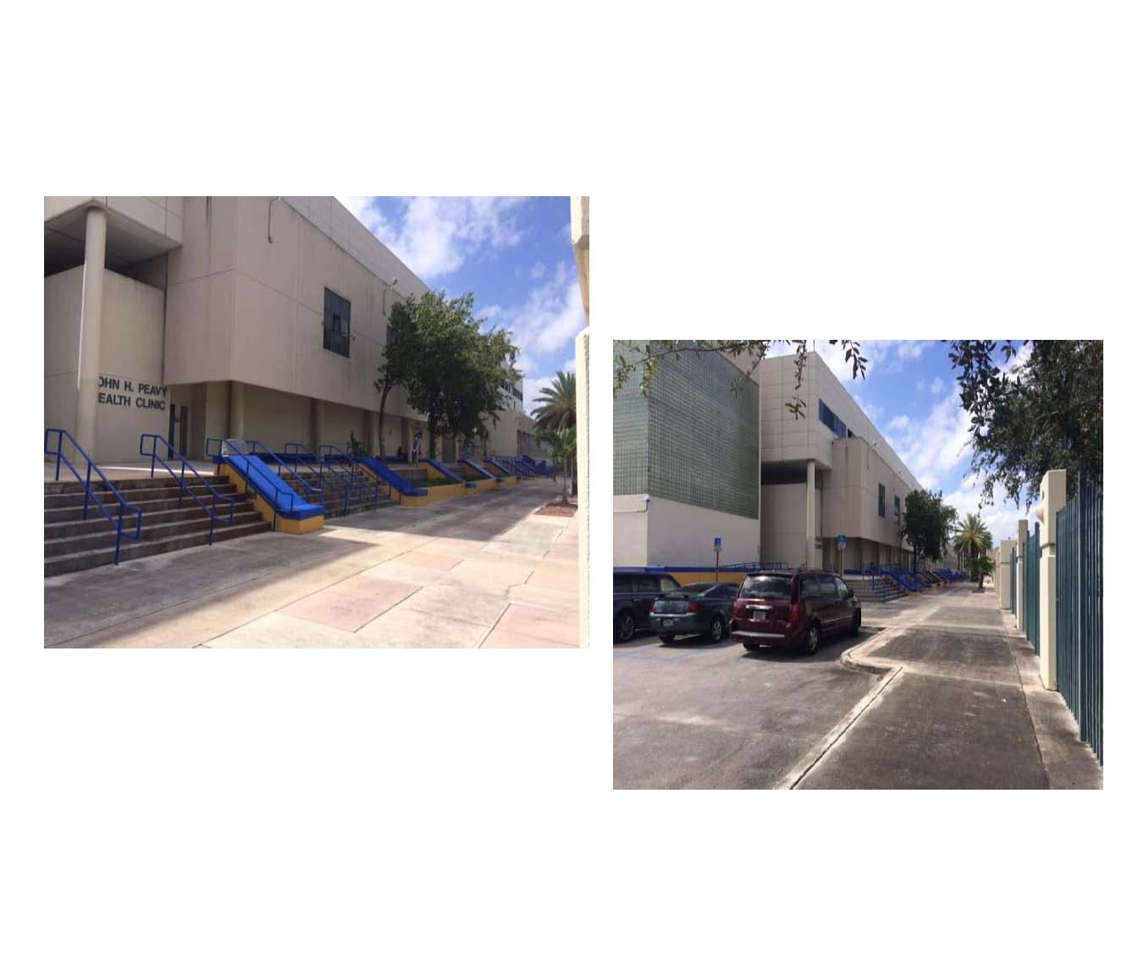
Community health clinic opens at Miami Northwestern High
https://www.youtube.com/watch?v=XFlxe5Dqsj4

Slide 29
Challenges
Reaching the potential patient population due to perceived health care costs among community members.
The primary means of health care community members have sought are via emergency room visits.
Minimum/No media advertising due to limited funds.
Current word of mouth reach due to low priority of health care concerns given the context of the many other worries the community faces (housing limitations, low income households, violence).

Slide 30
Strengths
Partner includes Jessie Trice Community Health Centers which is a long-standing Federally Qualified Health Center that knows the community well.
Jessie Trice understands the customer base, that includes being sensitive to linguist needs besides English (fluent in Spanish and Creole).
John H. Peavy clinic is a well-known health facility in Liberty City
Providers are Nurses that are certified and can provide Primary healthcare at a comprehensive level. Any other healthcare needs such as specialists can be referred to other Jessie Trice health facilities.
Relationship with the Children’s Trust and staff at Miami Northwestern High School.
Individual, group and family education (within clinic and at schools).
Network with local and community groups and schools, at their invitation or via connection from FIU Education Effect.
For upcoming appointments, automated system sends reminders via text message and telephone.
For patients seen and treated, the front desk attempts to follow up within 10 days to address any patient concerns.

Slide 32
Resources
Betancourt, J. R., Green, A. R., & Carrillo, J. E. 2002. Cultural competence in health care: Emerging frameworks and practical approaches. New York: The Commonwealth Fund
Ali-Faisal, S. F., Colella, T. J., Medina-Jaudes, N., & Scott, L. B. (2016). The effectiveness of patient navigation to improve healthcare utilization outcomes: A meta-analysis of randomized controlled trials. Patient Education and Counseling. doi:10.1016/j.pec.2016.10.014
SPNS Initiative: Systems Linkages and Access to Care, 2011-2016. (n.d.). Retrieved January 19, 2017, from https://hab.hrsa.gov/about-ryan-white-hivaids-program/spns-systems-linkages-and-access
Tho, P. C., & Ang, E. (2016). The effectiveness of patient navigation programs for adult cancer patients undergoing treatment: a systematic review. The JBI Database of Systematic Reviews and Implementation Reports, 14(2), 295. doi:10.11124/jbisrir-2016-2324

